Slide 1
Goal Trees and Problem Solving

Slide 2
Outline
Problem solving
  Review
  Goal trees
Problem Reduction
  Symbolic Integration [The start of AI]
  Box Staking Problem
Understanding Goal Trees
Conclusion

Slide 3
Problem solving - Review
As we concluded from previous lectures, successful problem solving is aided by:
  choosing the best representation for the problem, e.g., using visual perception
  identifying the initial and goal states
  identifying all possible states
  exposing constraints

Slide 4
Problem solving – Goal trees
A tree is commonly encountered data shape that allows representing nonlinear hierarchical relationships
A tree is a collection of structures called nodes connected using edges where a single node represents a value, a state or something meaningful

Slide 5
Problem solving – Goal trees
Properties of trees:
  A node may have multiple successors
  Nodes with at least one successor is called a parent and its successors are called children
  A node without a child is called a leaf node
  A node that has no parent is called the root
  Depth of a tree is the number of levels between the root and the farthest leaf node
    Depth of shown tree is 3

Slide 6
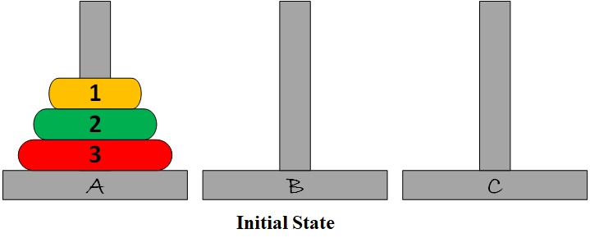
Tower Of Hanoi
The objective of the game is to move all n disks from pin A over to pin C but with the following constraints:
  You cannot place a larger disk onto a smaller disk.
  You can move one disk at a time
Example n = 3

Slide 7
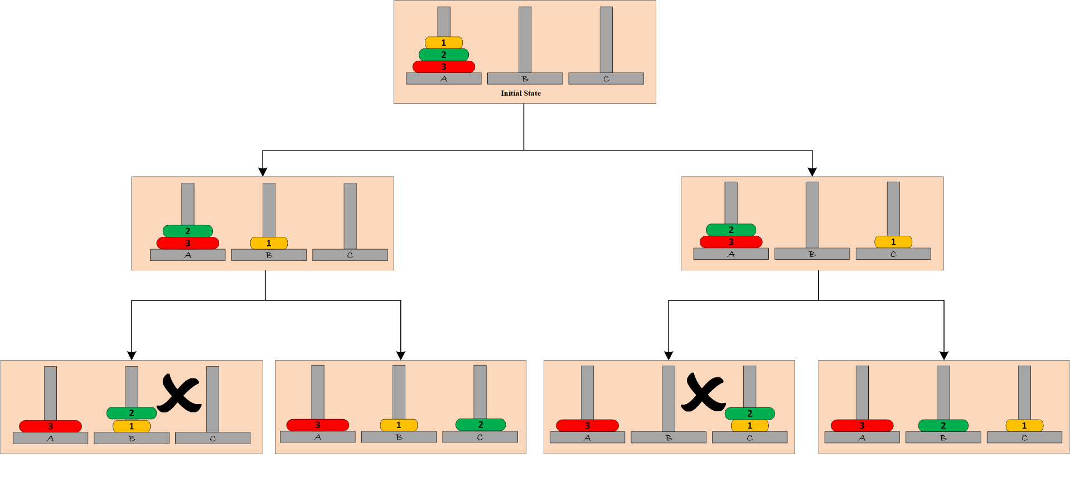
Example of Tower of Hanoi
The Tree starts from the Initial state and details the steps on how to reach the goal state
The above Tree is up to the 2nd level, you can continue until you reach the goal state.
Level 0
Level 1
violate constraints
violate constraints
Level 2
depth

Slide 8
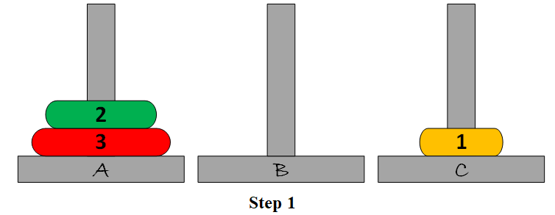
Example of Tower of Hanoi

Slide 9
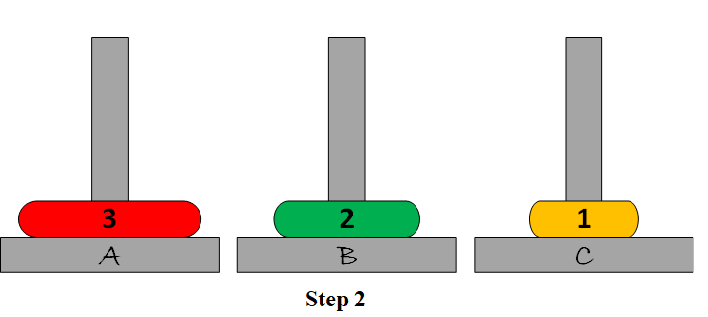
Example of Tower of Hanoi

Slide 10
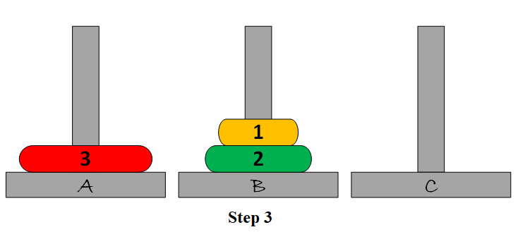
Example of Tower of Hanoi

Slide 11
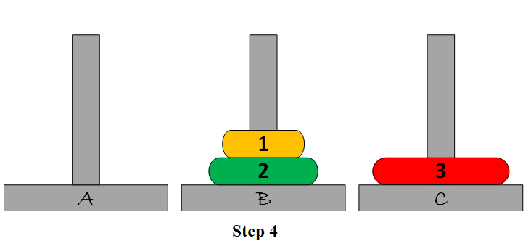
Example of Tower of Hanoi

Slide 12
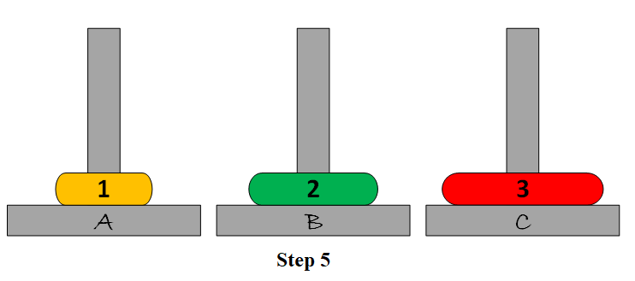
Example of Tower of Hanoi

Slide 13
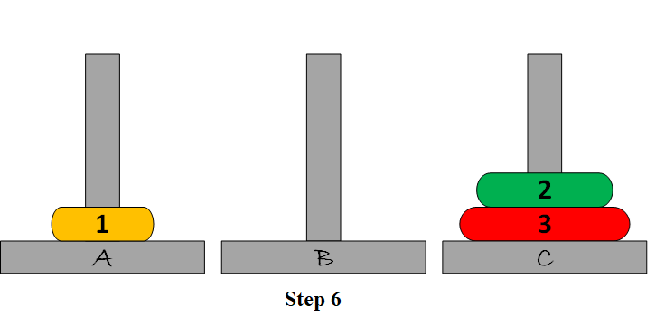
Example of Tower of Hanoi

Slide 14
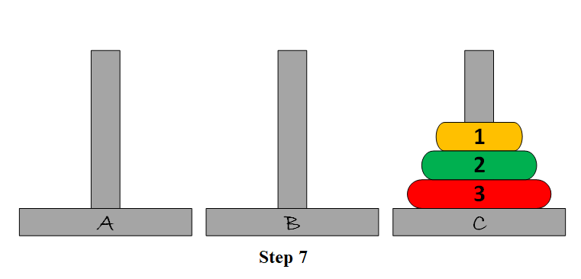
Example of Tower of Hanoi
Animation with n=4: https://www.openbookproject.net/py4fun/hanoi/hanoi3.html

Slide 15
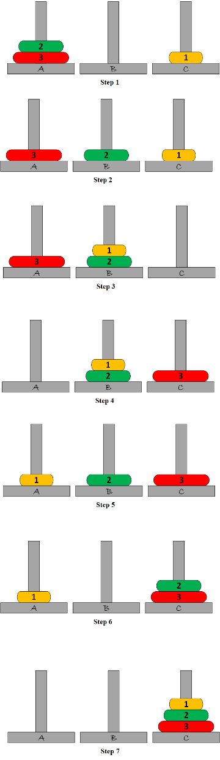
Example of Tower of Hanoi
One possible solution (path from root to goal) is shown on the right.
    If a computer program can give you the steps, is that program "Intelligent"?
    The program is not intelligent, but it is programmed in a way that makes it look intelligent. The core algorithm is only listing all possible combinations and eliminating states that do not satisfy the input constraints.
Attempt the problem if we have 7 disks instead of 3 (i.e., n =7).

Slide 16
Recursive Functions
A function defined in terms of itself
Example: Factorial Function (n!)
f(n) = n! = n x (n-1)! = n x f(n-1)
In Programming (Python), a recursive function is a function that calls itself
Creating such functions require:
  Basis step
  Recursive Step
# Non-Recursive definition
def fac1(n):
f = 1
for i in range(n, 1, -1):
f = f * i
return f
# Recursive definition
def fac2(n):
if n == 1 :
return 1 # basis step
else:
return n * fac2(n - 1) # Recursive step

Slide 17
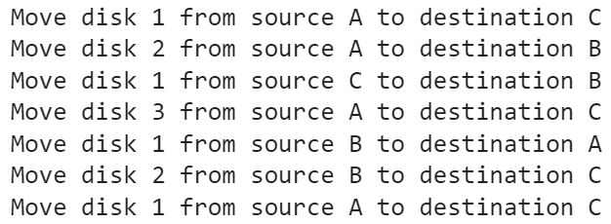
Example of Tower of Hanoi
# Recursive Python function to solve the tower of Hanoi
def TowerOfHanoi(n, source, destination, auxiliary):
if n==1:
print ("Move disk 1 from source", source, "to destination ",destination)
return
TowerOfHanoi(n-1, source, auxiliary, destination)
print ("Move disk", n, “from source", source, "to destination", destination)
TowerOfHanoi(n-1, auxiliary, destination, source)
# Driver code
n = 3
TowerOfHanoi(n,'A','C','B')
# A, C, B are the names of rods

Slide 18
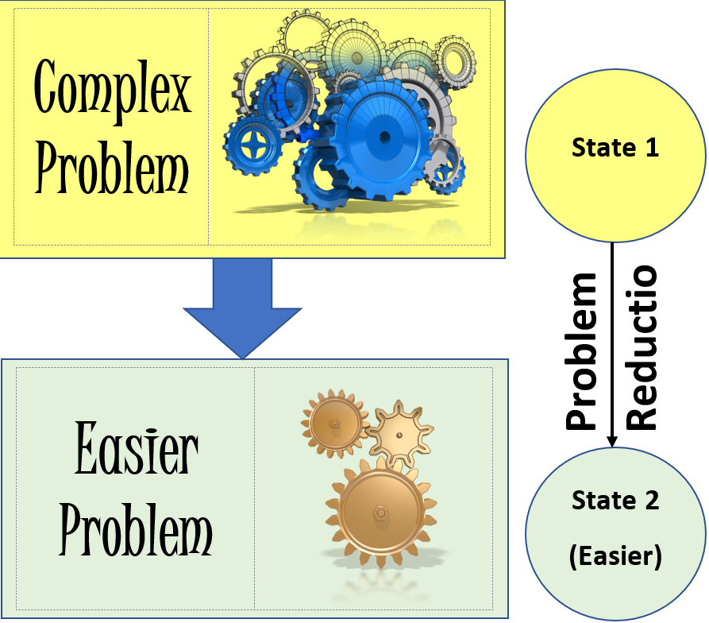
Problem Reduction
Sometimes we must divide the complex problem into different sets of easier independent problems
In problem reduction, we will use the Generate and Test methodology where we will try to generate different sub-solutions (sub-goals) then test them to see if the goal is reached
n

Slide 19
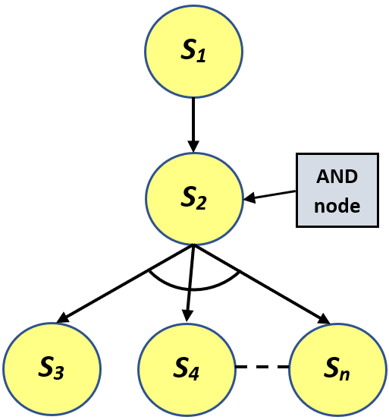
Problem Reduction
In problem reduction we will use a goal tree which is a form of tree structure used to represent problems that can be broken down into smaller problems
  Similar to that in Tower of Hanoi example
The state at which the problem is broken into different sets of independent problems is referred to as the AND node

Slide 20
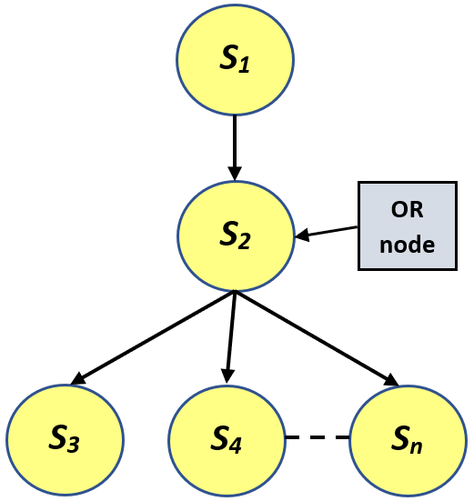
Problem Reduction
Sometimes we have different ways to solve the problem, so we use OR node like the one shown
Note that the AND node has the arch while the OR node does not

Slide 21
AND node vs. OR node
Note: the AND node has the arch whereas the OR node does not

Slide 22
AND-OR Shortcut
S₁
S₁
S₂
S₂
S’₂
S₅
S₃
S₄
S₅
S₃
S₄

Slide 23
Example of Tower Of Hanoi – Problem reduction
The root node, labeled “3AC” represents the original problem of transferring all 3 disks from A to C
The goal can be decomposed into three sub-goals: 2AB, 1AC, 2BC. In order to achieve the goal, all 3 sub-goals must be achieved.
3AC

Slide 24
Example of Tower Of Hanoi – Problem reduction
3AC
2AB

Slide 25
Example of Tower Of Hanoi – Problem reduction
3AC
2AB
1AC

Slide 26
Example of Tower Of Hanoi – Problem reduction
3AC
2AB
1AC
1AB

Slide 27
Example of Tower Of Hanoi – Problem reduction
3AC
2AB
1AC
1AB
1CB

Slide 28
Example of Tower Of Hanoi – Problem reduction
3AC
2AB
1AC
1AC
1AB
1CB

Slide 29
Example of Tower Of Hanoi – Problem reduction
3AC
2AB
1AC
2BC
1AC
1AB
1CB
1BA

Slide 30
Example of Tower Of Hanoi – Problem reduction
3AC
2AB
1AC
2BC
1AC
1AB
1CB
1BA
1BC

Slide 31
Example of Tower Of Hanoi – Problem reduction
3AC
2AB
1AC
2BC
1AC
1AB
1CB
1BA
1BC
1AC
https://www.youtube.com/watch?v=rf6uf3jNjbo

Slide 32
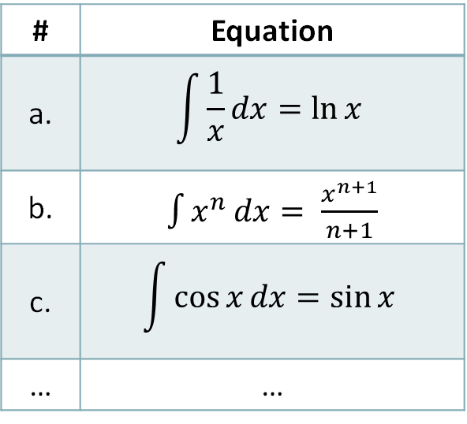

Symbolic Integration using Problem Reduction
The Start of AI was with Symbolic Integration
Can you integrate the following equation:
Given that you have an integral table as the following:
$$\int{\frac{{−5x}^{4}}{{(1−x^{2})}^{5/2}}dx}$$
# | Equation
a. | $$\int{\frac{1}{x}}dx=\ln{x}$$
b. | $\int{x^{n}}dx= \frac{x^{n+1}}{n+1}$
c. | $$\int{\cos{x}}dx=\sin{x}$$
… | …

Slide 33
Symbolic Integration using Problem Reduction
Modeling the way a human solves an integration problem
Solution approach:
  Simplify the integral given to an easier problem that will help us in solving the integral
Problem Reduction will utilize a known transform to reduce the original problem to a simpler one.
We will denote each step of problem reduction by a Node
Review your calculus basics!

Slide 34
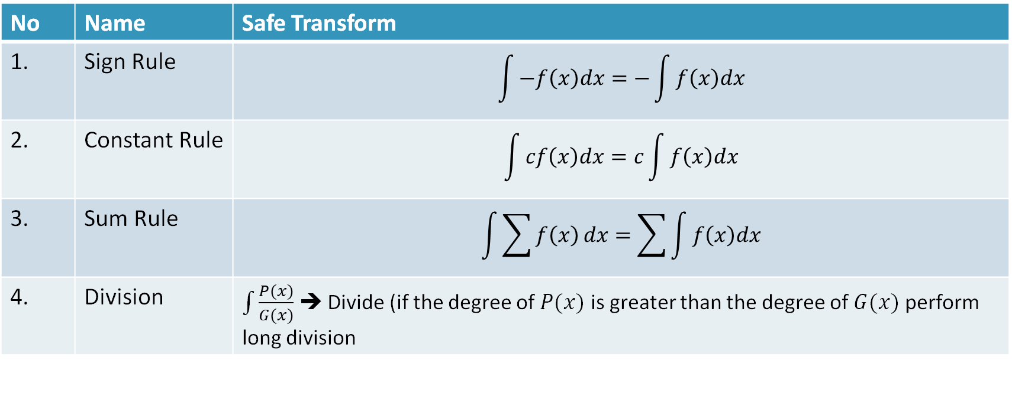
Review of Integration Facts
Safe Transformations: always good to do
No | Name | Safe Transform
1. | Sign Rule | $$\int{−f\left(x\right)dx=−\int{f\left(x\right)dx}}$$
2. | Constant Rule | $$\int{cf\left(x\right)dx=c\int{f\left(x\right)dx}}$$
3. | Sum Rule | $$\int{\sum{f\left(x\right)}dx=\sum{\int{f\left(x\right)dx}}}$$
4. | Division | $\int{\frac{P(x)}{G(x)}}$ ➔ Divide (if the degree of $P(x)$ is greater than the degree of $G(x)$ perform long division
Note that point 1 and 2 are the same but we will treat them differently for ease of understanding

Slide 35
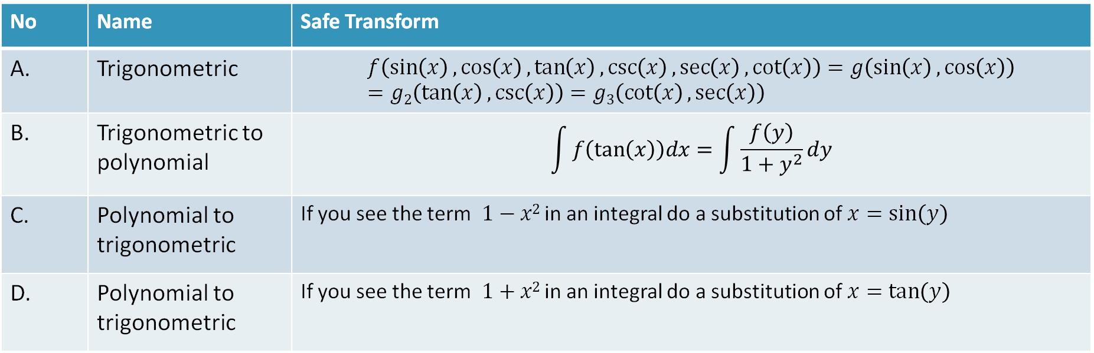
Review of Integration Facts
Heuristic Transformations: sometimes useful, do not always work
No | Name | Safe Transform
A. | Trigonometric | $$f\left(\sin\left(x\right),\cos\left(x\right),\tan\left(x\right),\csc\left(x\right),\sec\left(x\right),\cot\left(x\right)\right)=g\left(\sin\left(x\right),\cos\left(x\right)\right)=g2\left(\tan\left(x\right),\csc\left(x\right)\right)=g3\left(\cot\left(x\right),\sec\left(x\right)\right)$$
B. | Trigonometric to polynomial | $$\int{f\left(\tan\left(x\right)\right)dx=\int{\frac{f\left(y\right)}{1+y^{2}}dy}}$$
C. | Polynomial to trigonometric | If you see the term $1−x2$ in an integral do a substitution of $x=\sin\left(y\right)$
D. | Polynomial to trigonometric | If you see the term $1+x2$ in an integral do a substitution of $x=\tan\left(y\right)$

Slide 36
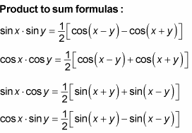
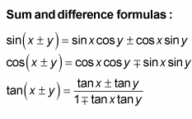
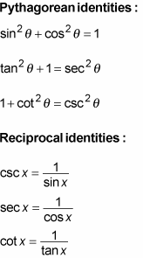
Trigonometric Identities

Slide 37
Solving the Symbolic Integration Problem
We will use Generate and Test methodology as shown below:

Slide 38
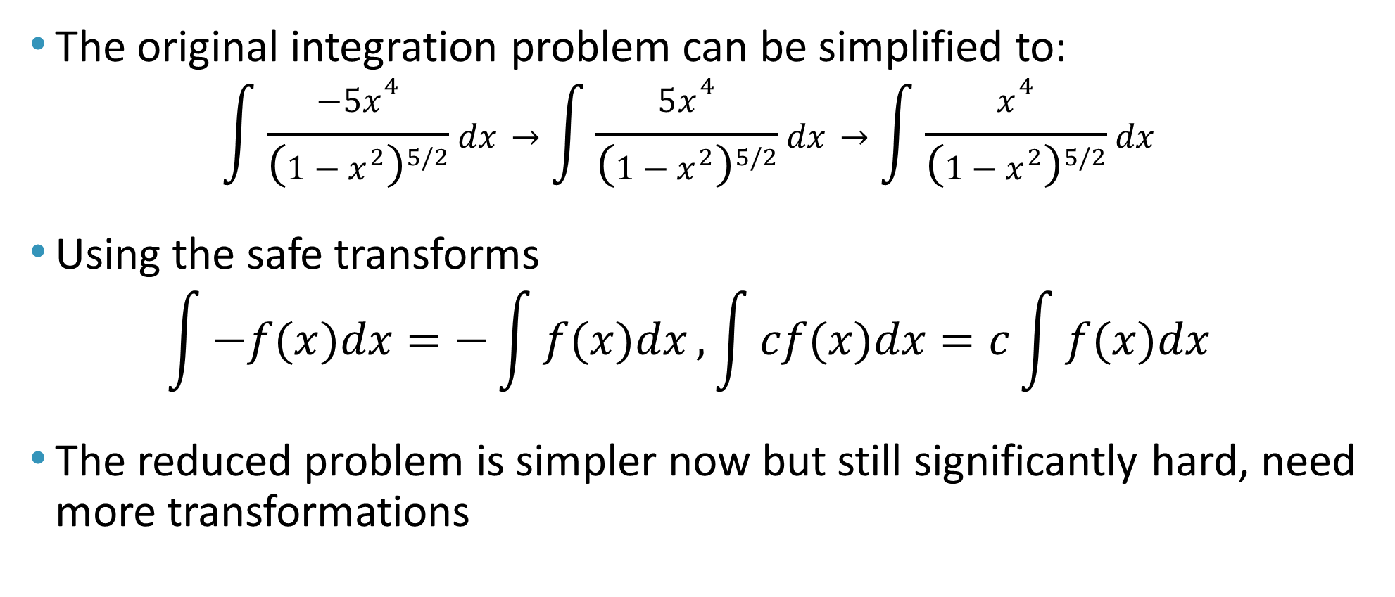
Symbolic Integration Problem
The original integration problem can be simplified to:
$$\int{\frac{−5x^{4}}{{\left(1−x^{2}\right)}^{5/2}}dx}→\int{\frac{5x^{4}}{{\left(1−x^{2}\right)}^{5/2}}dx}→\int{\frac{x^{4}}{{\left(1−x^{2}\right)}^{5/2}}dx}$$
Using the safe transforms
$$\int{−f(x)dx}=−\int{f(x)dx},\int{cf(x)dx}=c\int{f(x)dx}$$
The reduced problem is simpler now but still significantly hard, need more transformations

Slide 39
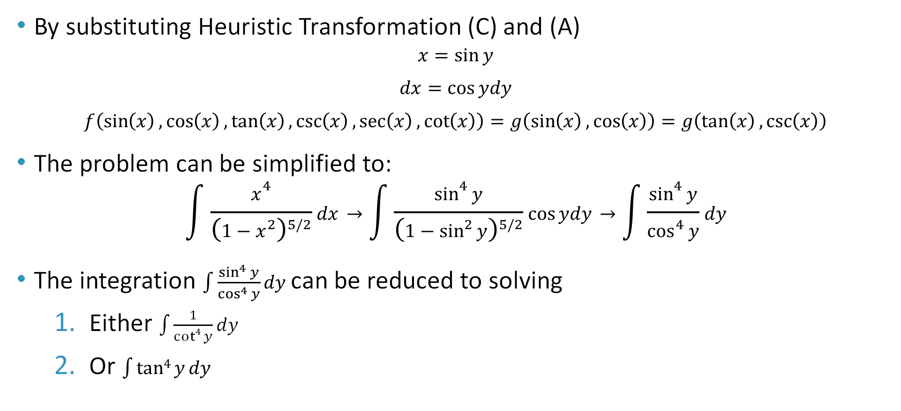
Symbolic Integration Problem
By substituting Heuristic Transformation (C) and (A)
$$x=\sin{y}$$
$$dx=\cos{ydy}$$
$$f\left(\sin\left(x\right),\cos\left(x\right),\tan\left(x\right),\csc\left(x\right),\sec\left(x\right),\cot\left(x\right)\right)=g\left(\sin\left(x\right),\cos\left(x\right)\right)=g\left(\tan\left(x\right),\csc\left(x\right)\right)$$
The problem can be simplified to:
$$\int{\frac{x^{4}}{{\left(1−x^{2}\right)}^{5/2}}dx}→\int{\frac{\sin^{4}⁡y}{{\left(1−\sin^{2}⁡y\right)}^{5/2}}cos⁡ydy}→\int{\frac{\sin^{4}⁡y}{\cos^{4}⁡y}dy}$$
The integration $\int{\frac{\sin^{4}⁡y}{\cos^{4}⁡y}dy}$ can be reduced to solving
Either $\int{\frac{1}{cot4{y}}dy}$
Or $\int{tan4{y}dy}$
which one will you choose?

Slide 40
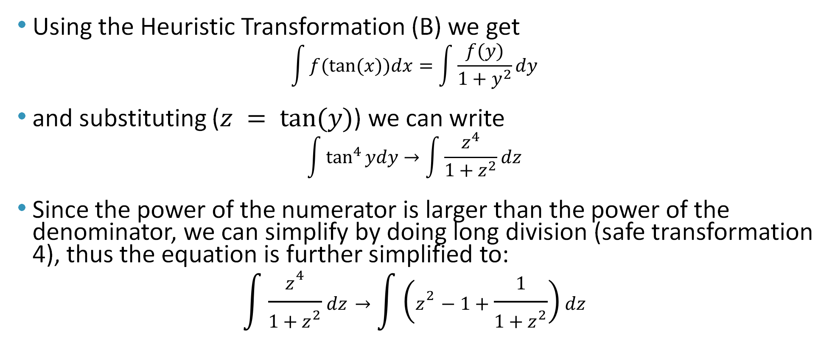
Symbolic Integration Problem
Using the Heuristic Transformation (B) we get
$$\int{f(tan⁡(x))dx}=\int{\frac{f(y)}{1+y^{2}}dy}$$
and substituting ($z = tan⁡(y)$) we can write
$$\int{\tan^{4}⁡ydy}→\int{\frac{z^{4}}{1+z^{2}}dz}$$
Since the power of the numerator is larger than the power of the denominator, we can simplify by doing long division (safe transformation 4), thus the equation is further simplified to:
$$\int{\frac{z^{4}}{1+z^{2}}dz}→\int{\left(z^{2}−1+\frac{1}{1+z^{2}}\right)dz}$$

Slide 41
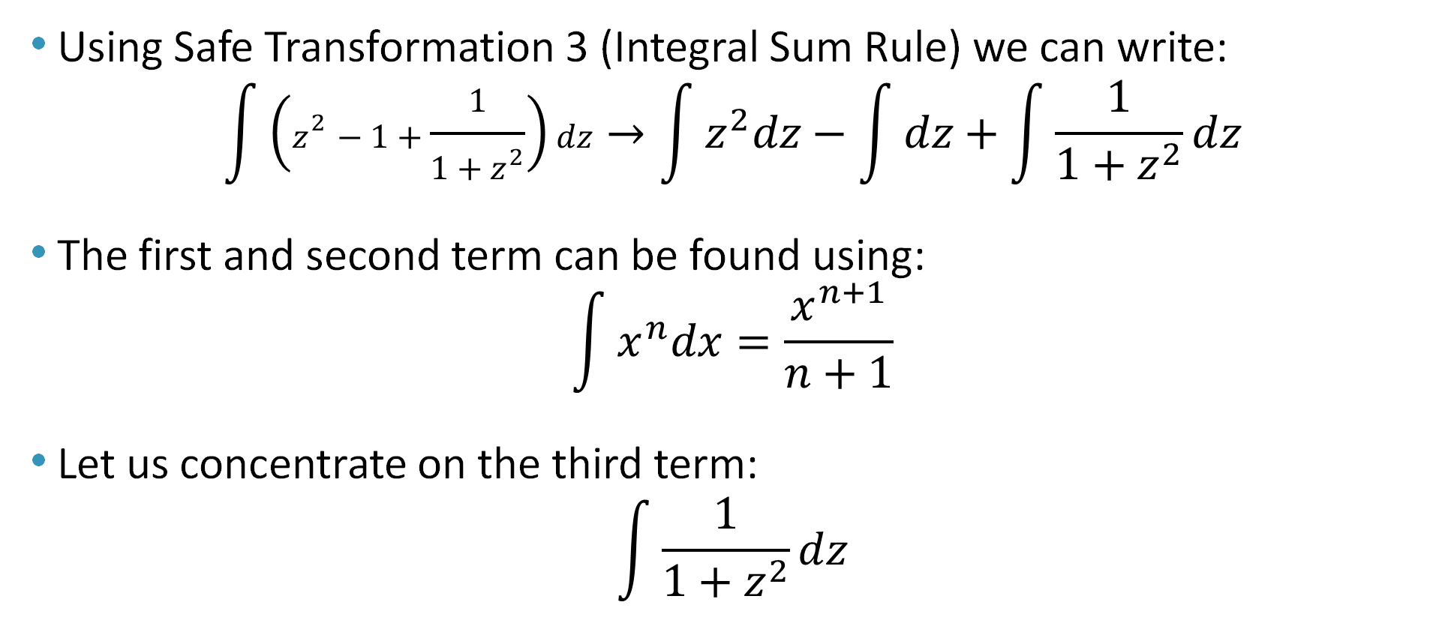
Symbolic Integration Problem
Using Safe Transformation 3 (Integral Sum Rule) we can write:
$$\int{\left(z^{2}−1+\frac{1}{1+z^{2}}\right)dz}→\int{z^{2}dz}−\int{dz}+\int{\frac{1}{1+z^{2}}dz}$$
The first and second term can be found using:
$$\int{x^{n}dx}=\frac{x^{n+1}}{n+1}$$
Let us concentrate on the third term:
$$\int{\frac{1}{1+z^{2}}dz}$$

Slide 42
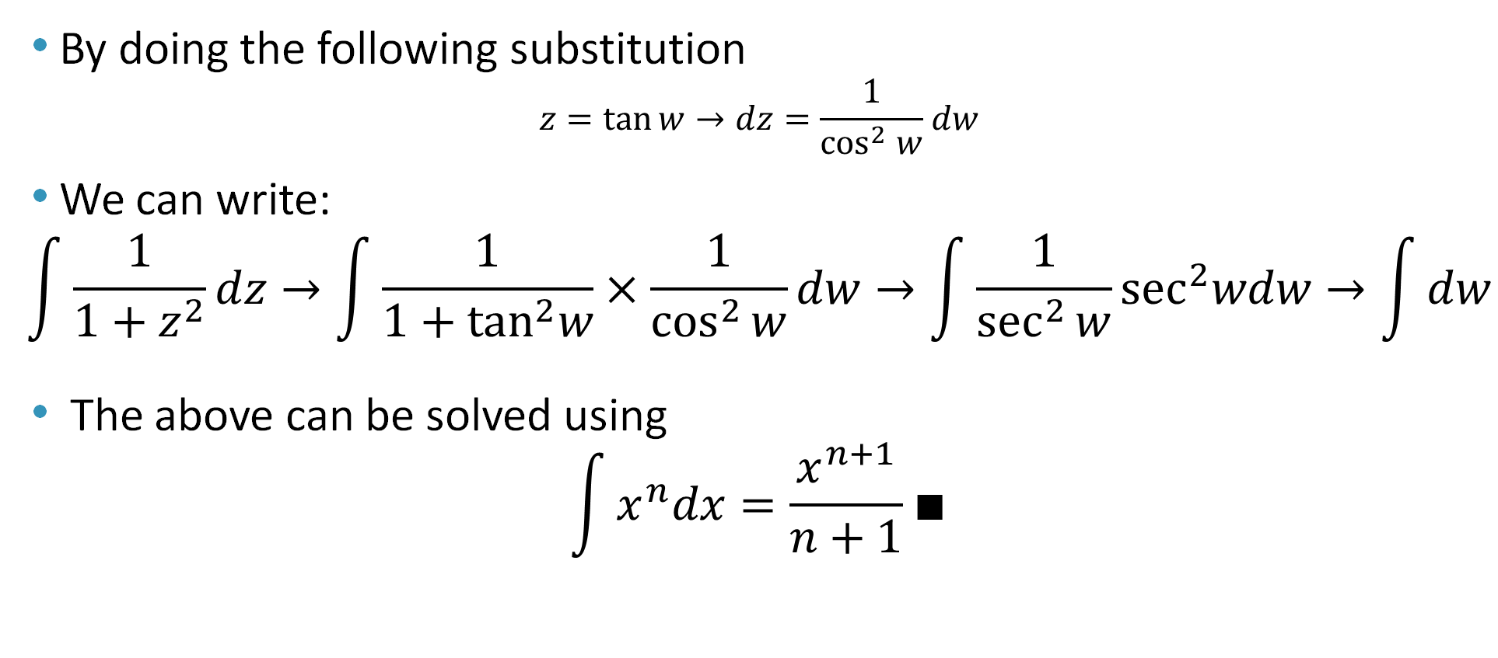
Symbolic Integration Problem
By doing the following substitution
$$z=tan⁡w→dz=\frac{1}{\cos^{2}{w}}dw$$
We can write:
$$\int{\frac{1}{1+z^{2}}dz}→\int{\frac{1}{1+\tan^{2}w}×\frac{1}{\cos^{2}{w}}dw}→\int{\frac{1}{\sec^{2}{w}}\sec^{2}wdw}→\int{dw}$$
The above can be solved using
$$\int{x^{n}dx}=\frac{x^{n+1}}{n+1}∎$$

Slide 43
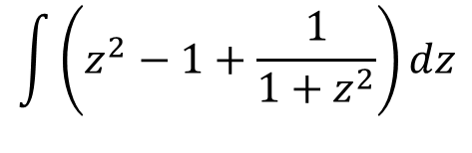

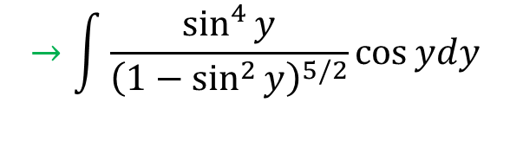
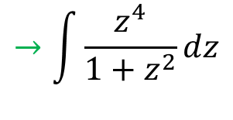
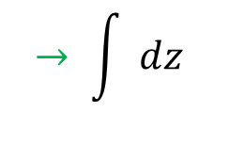
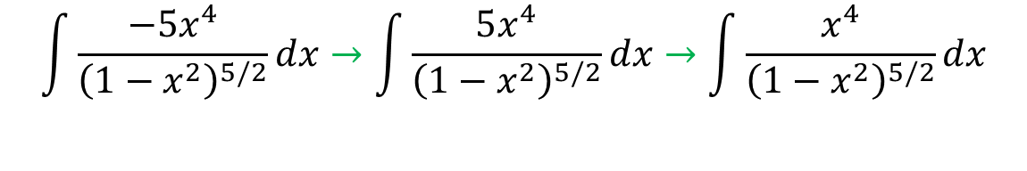
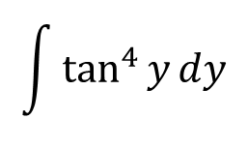
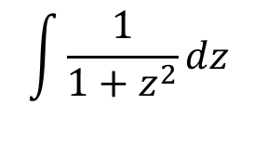
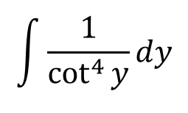
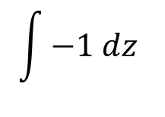
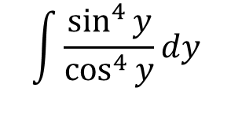
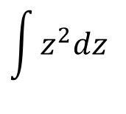
Symbolic Integration Problem (Summary)
A
B
C
D
$$\int{\frac{−5x^{4}}{{\left(1−x^{2}\right)}^{5/2}}dx}→\int{\frac{5x^{4}}{{\left(1−x^{2}\right)}^{5/2}}dx}→\int{\frac{x^{4}}{{\left(1−x^{2}\right)}^{5/2}}dx}$$
$$→\int{\frac{\sin^{4}⁡y}{{\left(1−\sin^{2}⁡y\right)}^{5/2}}cos⁡ydy}$$
F
$$\int{\frac{1}{\cot^{4}{y}}dy}$$
E
$$\int{\frac{\sin^{4}⁡y}{\cos^{4}⁡y}dy}$$
G
H
$$\int{\tan^{4}{y}dy}$$
$$→\int{\frac{z^{4}}{1+z^{2}}dz}$$
J
$$\int{z^{2}dz}$$
I
K
L
$$\int{\left(z^{2}−1+\frac{1}{1+z^{2}}\right)dz}$$
$$\int{−1 dz}$$
$$→ \int{ dz}$$
M
N
$$\int{\frac{1}{1+z^{2}}dz}$$
$$→\int{dw}$$

Slide 44
Symbolic Integration Problem - Goal Trees
Rearranging nodes with symbols we get
A Goal Tree
A
B
C
D
E
F
G
H
I
J
K
M
L
N

Slide 45
Understanding Goal Trees
General Tree structure
  A tree has nodes and edges where edges connect two nodes within the tree
  A branch appears when the node has more than one edge
  A tree depth is the number of levels in the goal tree to reach to the solution
The tree depth for the integration problem is 9
A
B
C
D
E
F
G
H
I
J
K
M
L
N

Slide 46
Understanding Goal Trees
Tree depth gives a lot of information such as:
  Complexity of the problem: As the tree depth grows, the problem is viewed as being more complex since it needs more steps to solve the problem
  The complexity can be used to identify the level of intelligence. An entity (such as a person, computer, etc.) that can solve a problem with a higher tree depth is more intelligent than programs that solve less depth problem
  Note multiple solutions of a problem exist with different tree depth, the smart choice is to use the shortest tree.

Slide 47
Understanding Goal Trees
In the integration program, the following was observed:
  The program was given 56 freshman-level problems from which it solved 54 difficult problems and failed in two.
  The worst-case tree depth of the 56 problems was 7 (taking away the -5; our example)
  Average tree depth for solving integration problems was 3
  Number of unused branches is 1 (i.e., did not need to solve it to produce a solution (just like node F in the tree)
A
B
C
D
E
F
G
H
I
J
K
M
L
N

Slide 48
Strategy to Solve Symbolic Integration Summary
Start with safe transformations, the ones you are sure will work in any case. Then apply heuristic transformations, the ones that could work.
The problem simplification schema, may create
  "and node" where the problem forks in several sub problems and
  "or node" where the problem may be solved with either one or another transformation.
The resulting schema is usually called a "problem reduction tree", "and/or tree" or "goal tree".
Note: In an "or node", it helps to understand the depth of functional composition (number of transformations to be applied after the "or" options of the branch) and the simplicity of solving each option to complete the problem resolution.

Slide 49
To get the Goal Tree of a Certain Problem
Start by evaluating what kind of knowledge is involved. [Integration Tables; Transformations; Goal Tree]
Understand how the knowledge is represented. Each category of knowledge has its own way of being represented. [Expressions; Tables; Goal Trees as Procedures]
Know how the knowledge is used.[Transformations to make problems simpler; Integration Tables to trim bottom of Tree]
Know how much knowledge is required to solve the problem. [26 integration tables; 12 safe transformations; 12 heuristic transformations]

Slide 50
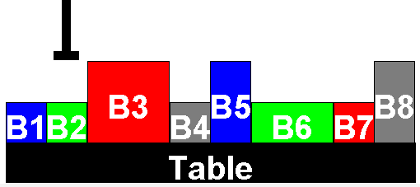
Goal Trees Application: Box Stacking Problem
Box Stacking is a typical application of Goal Trees.
Given figure shows the distribution of boxes on top of a table. The shown arm can pick a box, move it and place it in another location.
The goal is to place some box x on top of another box y with the following constraints:
  The robot arm can only handle a single box at a time
  A box can be placed on an empty space on the table or on top of another box
  Can not put a box with larger width on top of a box with smaller width
Robot Arm

Slide 51
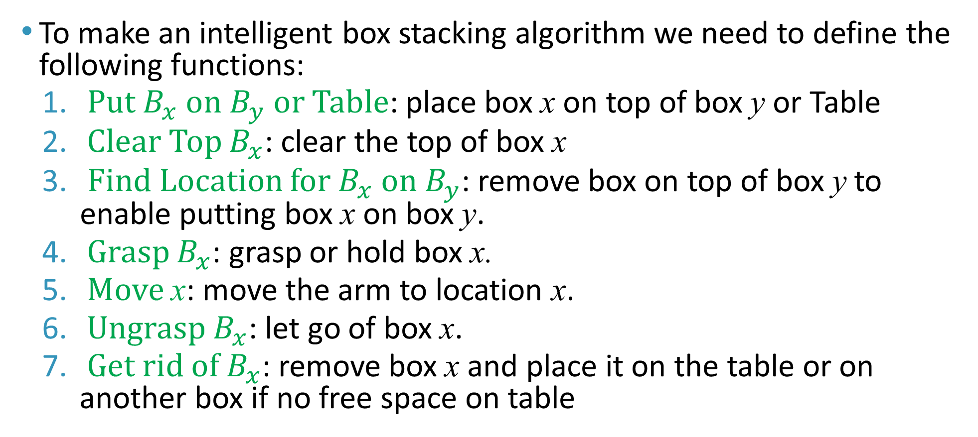
Goal Trees Application: Box Stacking Problem
To make an intelligent box stacking algorithm we need to define the following functions:
  Put $B_{x}$ on $B_{y}$ or Table: place box x on top of box y or Table
  Clear Top $B_{x}$: clear the top of box x
  Find Location for $B_{x}$ on $B_{y}$: remove box on top of box y to enable putting box x on box y.
  Grasp $B_{x}$: grasp or hold box x.
  Move x: move the arm to location x.
  Ungrasp $B_{x}$: let go of box x.
  Get rid of $B_{x}$: remove box x and place it on the table or on another box if no free space on table

Slide 52
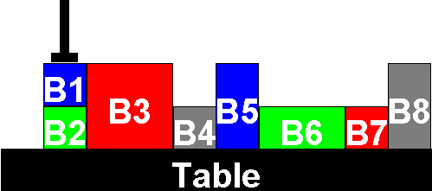
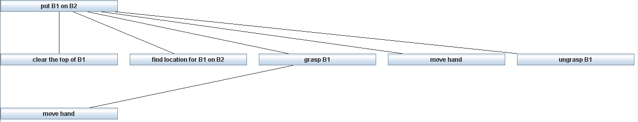
Goal Trees Application: Box Stacking Problem
Put B1 on B2
The generated goal tree is as follows

Slide 53
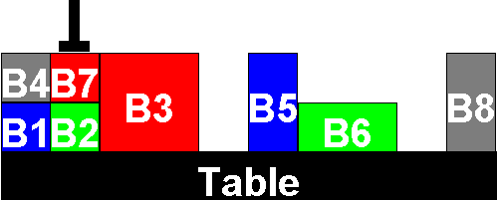
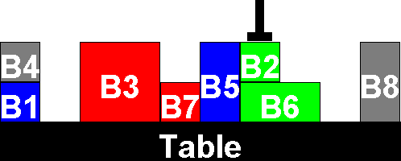
Goal Trees Application: Box Stacking Problem
Put B2 on B6
Not that B7 is blocking the arm from grasping B2
We need to get rid of B7 by placing it on the table
To ger rid of B7, we call the function put B7 on Table

Slide 54
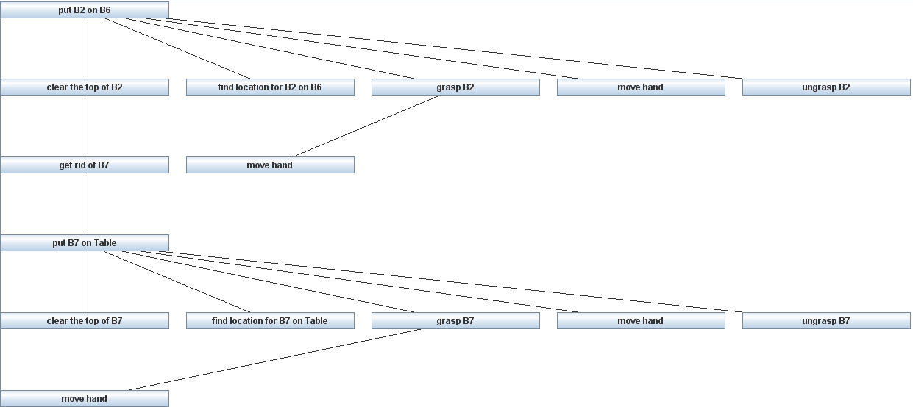
Goal Trees Application: Box Stacking Problem
The generated goal tree is as follows

Slide 55
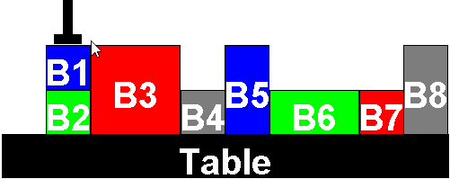
Goal Trees Application: Box Stacking Problem
Put B1 on B2
Not that B4 and B7 are blocking the arm from grasping B1 and releasing it on top of B2.
We need to get rid of B4 and B7 by placing them on the table
To get rid of B4, we call the function put B4 on Table
To get rid of B7, we call the function put B7 on Table

Slide 56
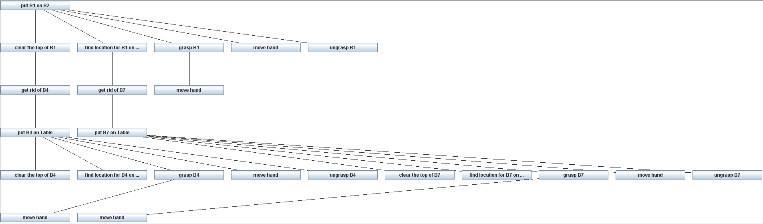
Goal Trees Application: Box Stacking Problem
The generated goal tree is as follows

Slide 57
Goal Trees Application: Box Stacking Problem
Structuring the function as shown enables building programs that can answer questions about their behavior.
Such structure can answer “How” and “Why” questions.
  The answer to “How” question is going down in the tree level by level
  The answer to “Why” question is going up in the tree by one level
At the early stages, such programs were considered “intelligent” programs.

Slide 58
Conclusion
Many problems can be visually represented in form of goal trees
Trees aid our understanding of the problem and show the difficulty of the problem by looking at the depth of the tree
A Goal Tree program can answer questions about its own behavior by reporting steps up (why questions) or down (how questions) in the actions it takes.

